Slide 1
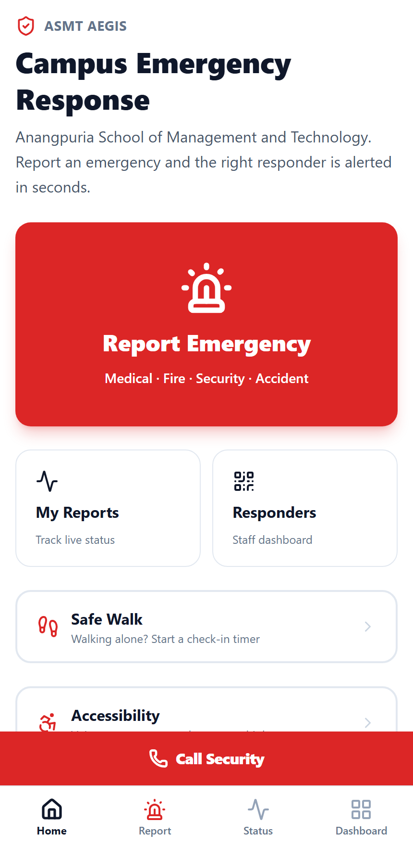
A.S.M.T. HACKATHON 2K26 · TEAM BHAND CODERS
ASMT AEGIS
Campus emergency response for a three-block college.
Scan a QR code, hold one button — the right responder is paged in seconds, with the urgency already judged.
Vibhor Mehta
Devanshu Gupta
Sunny Gujjar
asmt-aegis.vercel.app
Anangpuria School of
Management & Technology
TEAM
BUILT BY
LIVE NOW
Bhand Coders🍁
ASMT Aegis · Bhand Coders🍁

Slide 2
02
What ASMT Aegis does
One app. Report in 15 seconds, and the right responder is paged automatically.
Scan a QR, no typing
Hold SOS for two seconds
Urgency judged automatically
QR codes posted in every block open the report form with the block and floor already filled in.
Pick the emergency type, describe it by typing or voice, add a photo, and hold the red button. No login needed.
A rule engine plus an AI second opinion marks it Critical, Urgent or Normal before anyone reads it.
Paged on Telegram instantly
Reporter sees it live
Medical, security or warden for that block gets the alert instantly. No answer in 60 seconds? It escalates by itself.
A live timeline shows classified, notified, acknowledged, and an ETA once a responder accepts.
Works with the AI down, a responder offline, or no network at all. Call Security and SMS fallbacks are one tap away on every screen.
ASMT Aegis · Bhand Coders · asmt-aegis.vercel.app

Slide 3
03
How a report becomes a response
END TO END IN UNDER A MINUTE
1
2
3
4
5
6
Scan
Report
Classify
Page
Track
Escalate
A QR code posted in the block opens the form with the location already filled in.
→
Pick a type, describe it by typing or voice, add a photo. Hold SOS for two seconds.
→
Rule engine runs first and always. AI adds a second opinion under a 4-second timeout.
→
Telegram alert to the on-duty responders for that block and role.
→
The reporter watches the live timeline and sees an ETA once someone accepts.
→
No acknowledgement in 60 seconds? It pages the next tier by itself.
15s
3
2
0
to file a report
escalation tiers
languages, spoken and understood
logins needed to report
Every step degrades gracefully: classification survives the AI being down, alerts survive a responder being offline, and the report itself survives having no network at all.
ASMT Aegis · Bhand Coders · asmt-aegis.vercel.app

Slide 4
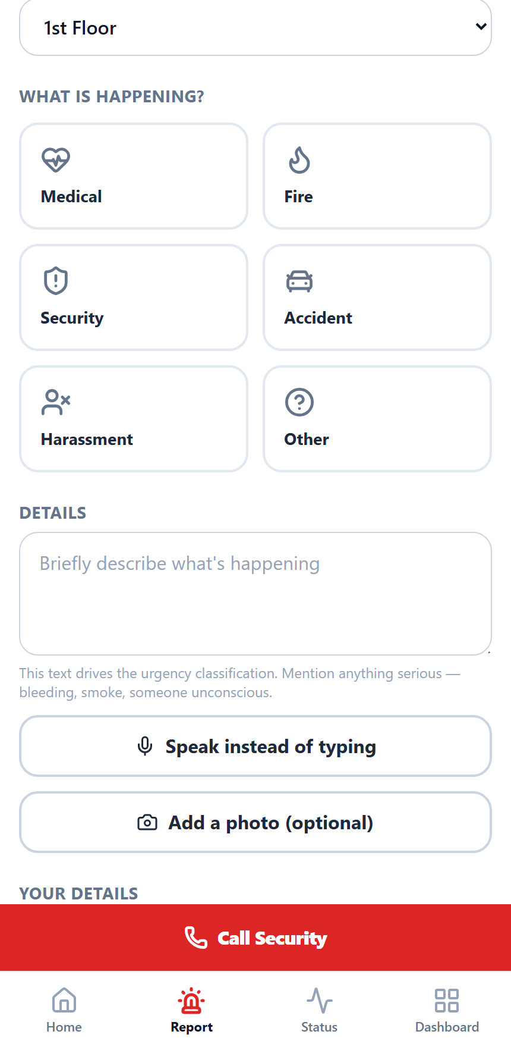
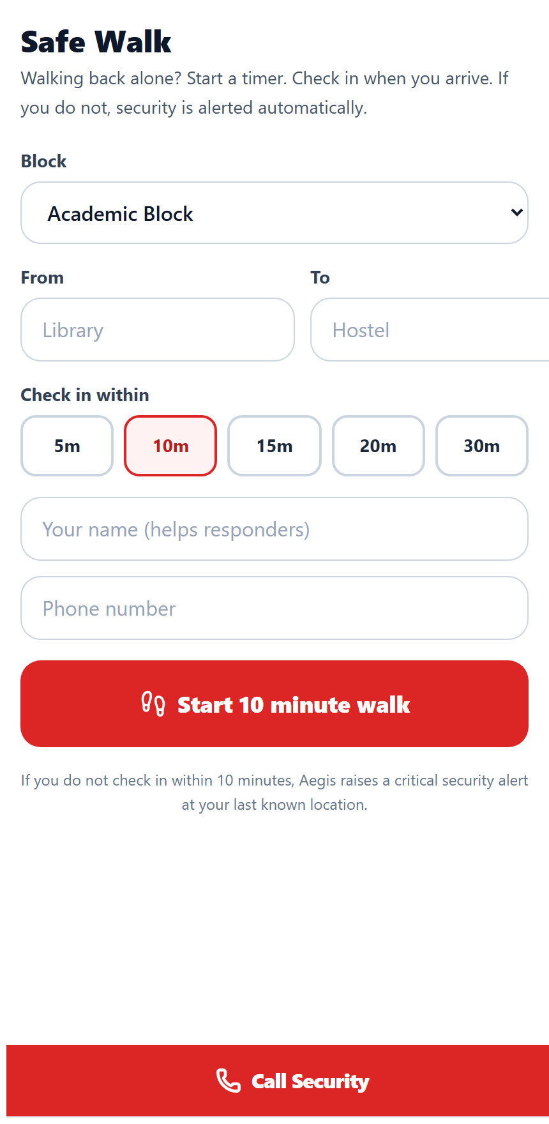
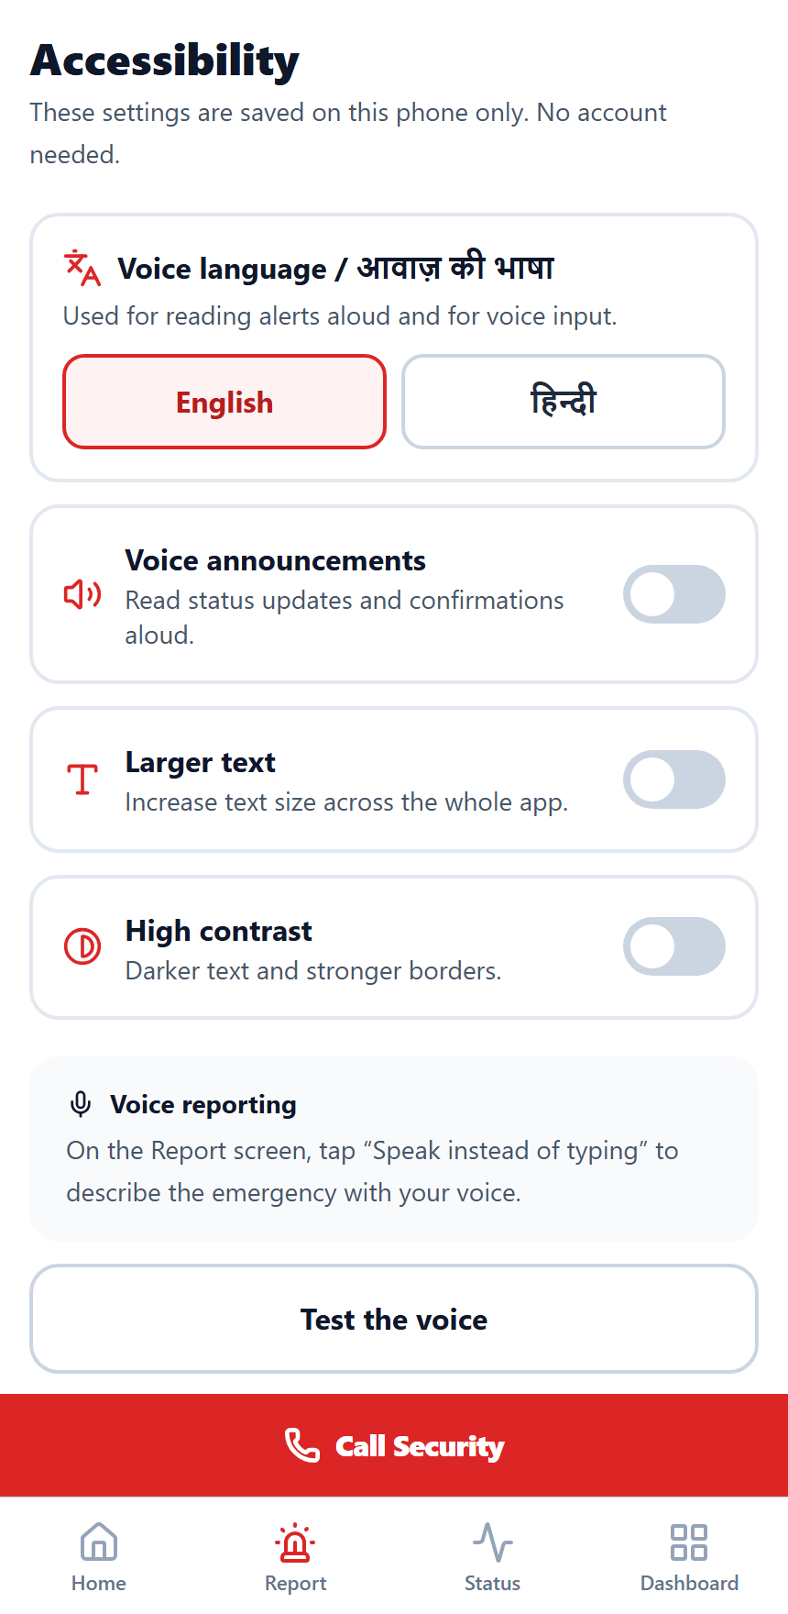
04
The app
CAPTURED FROM THE LIVE DEPLOYMENT
Home
Report an emergency
Safe Walk
Accessibility
One oversized action
Location pre-filled by QR
A timer that alarms on silence
Hindi voice, large text, contrast
Installable on iOS and Android — no app store. Anonymous reporting, optional photo evidence, and voice input for anyone who cannot type or see the screen.
ASMT Aegis · Bhand Coders🍁 · asmt-aegis.vercel.app

Slide 5
05
The part that makes it smart
AND THE PART THAT MAKES IT RELIABLE
TWO STAGES, AND THE RULE THAT COMBINES THEM
Stage 1 — rule engine. A deterministic keyword scan that always runs and cannot fail. Reads English, Hindi (Devanagari) and romanised Hinglish, so “बेहोश” and “behosh” both trigger critical.
Stage 2 — AI second opinion. One prompt with the type, description, location and time, under a hard 4-second timeout. Provider swappable between OpenAI and Anthropic with one environment variable.
final = MAX(rule, ai). The AI can raise a report's priority, but it can never talk the system down from a rule-matched emergency.
REAL OUTPUT FROM THE DEPLOYED SYSTEM
description "Student collapsed near the
stairs and is not breathing"
rule_priority critical
rule_matched ["not breathing",
"collapsed"]
ai_priority null (429, no credit)
final_priority critical
telegram delivered
── same pipeline, Hindi ──────────────
description "छात्र बेहोश है और
खून बह रहा है"
rule_priority critical
final_priority critical
Our AI key ran out of credit mid-build. The alert still went out, correctly marked CRITICAL — because the rule engine never depended on it. That is the design working, not a lucky escape.
ASMT Aegis · Bhand Coders · asmt-aegis.vercel.app

Slide 6
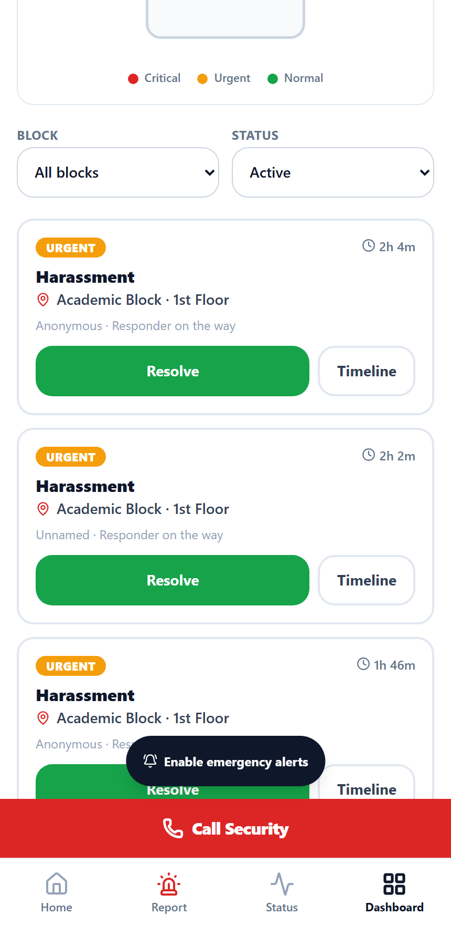
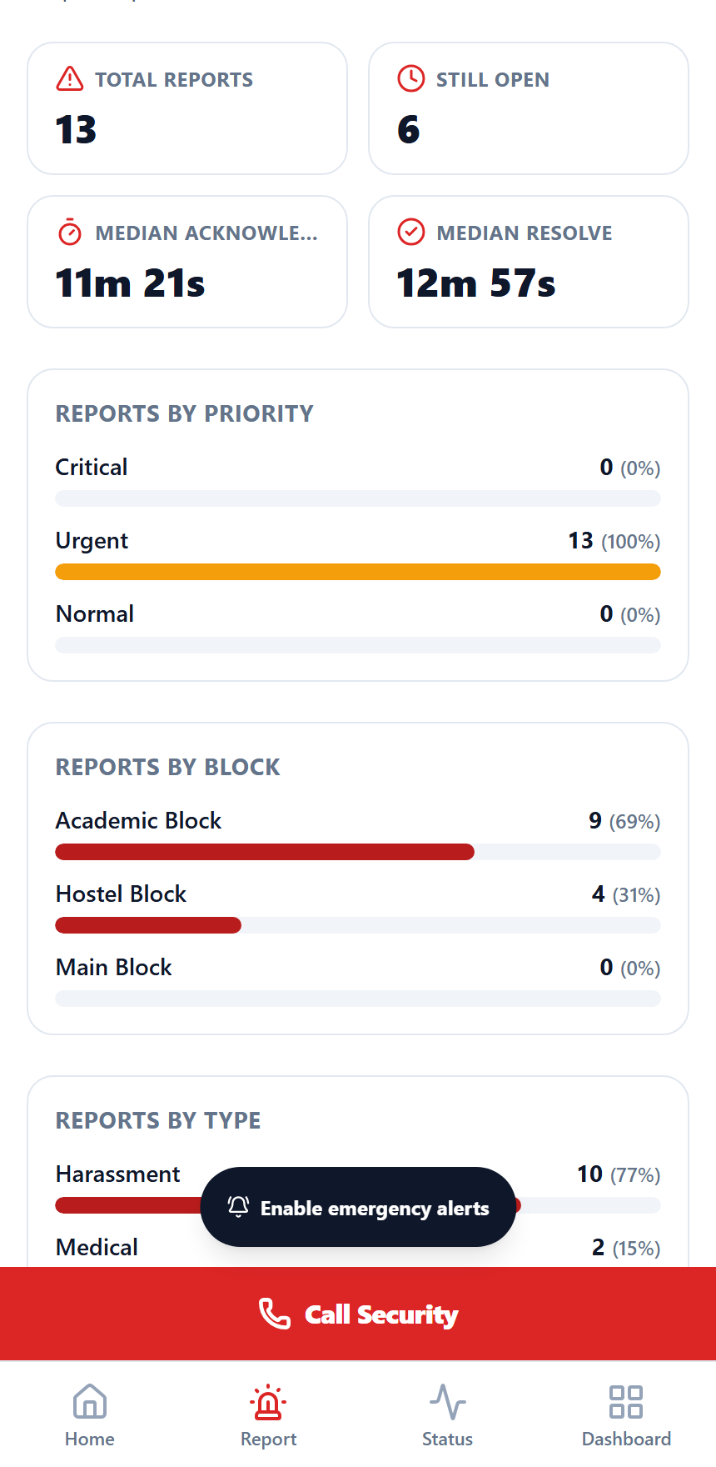
06
The responder side
WHERE THE ALERT ACTUALLY LANDS
Sorted by priority, then by who has waited longest. Critical cards flash and sound a looping alarm until someone acknowledges.
Acknowledge captures the responder's position, so the reporter immediately sees a real distance-based ETA instead of an open-ended “on the way”.
Interrupts staff on any screen. A signed-in responder gets a takeover alert and an OS notification wherever they are in the app — one tap to the incident.
Duplicate grouping. Five people reporting one fire produce one alert, shown as “Confirmed by 5 people” — not five separate pages.
Analytics that matter operationally: median time to acknowledge and to resolve, broken down by block, type and hour of day.
QR generator built in — print every location code, four to a page, and post them around campus.
Live incident board
Response analytics
ASMT Aegis · Bhand Coders · asmt-aegis.vercel.app

Slide 7
07
Designed for the day it fails
RESILIENCE AND ACCESS
NO NETWORK
NO DATA AT ALL
SOCKET BLOCKED
Offline outbox
Voice and SMS fallback
Triple-redundant sync
A failed report is stored in IndexedDB and sends itself the moment signal returns.
A permanent Call Security bar and a pre-filled emergency SMS, both working on cellular voice.
Realtime, plus a resync on every reconnect, plus polling. The screen cannot silently freeze.
AI UNAVAILABLE
CANNOT SEE THE SCREEN
CANNOT ASK FOR HELP
Rule engine carries it
Voice accessibility
Safe Walk
Classification never depends on a third-party API being up or funded.
Status read aloud in Hindi or English, dictation instead of typing, large text and high contrast.
A missed check-in raises a critical incident automatically at the walker's last known position.
Lighthouse on the live site: 97 performance · 100 accessibility · 100 best practices · 100 SEO
ASMT Aegis · Bhand Coders · asmt-aegis.vercel.app

Slide 8
08
Built with, and how to try it
STACK
TRY IT IN 60 SECONDS
FRONTEND
DATABASE
1 Open asmt-aegis.vercel.app on your phone
2 Tap Report, choose a type, describe it
3 Hold SOS for two seconds
4 Watch it classify and notify, live
5 Open /dashboard and tap Acknowledge
Next.js 14 · TypeScript · Tailwind CSS
Supabase PostgreSQL · Row Level Security
REALTIME
AI
Supabase Realtime + polling fallback
OpenAI / Anthropic, swappable by env var
ALERTING
PLATFORM
Telegram Bot API, routed by block and role
Installable PWA, deployed on Vercel
VERIFIED WORKING, END TO END
TEAM BHAND CODERS🍁
Rule-engine classification in English, Hindi and Hinglish
Telegram alerts, three-tier auto-escalation, duplicate grouping
Live tracking, responder ETA, Safe Walk, offline outbox, analytics
QR deep links, anonymous reporting, photo and voice input
Vibhor Mehta
Devanshu Gupta
Sunny Gujjar
Anangpuria School of Management and Technology
ASMT Aegis · Bhand Coders · asmt-aegis.vercel.app

